Slide 1

Navigating the Future of Work
1. Navigate Technological Disruptions Understand automation risks to focus on roles less likely to be replaced by AI.
2. Maximize Earning Potential Analyze salary trends to choose careers with competitive pay and financial alignment.
3. Plan for Long-Term Career Growth Use growth projections to align career paths with stable and advancing roles.
4. Identify In-Demand Skills Recognize valued skills and tailor education to meet industry needs.
5. Adapt to Regional and Global Dynamics Understand job trends by location to find the best prospects globally.
6. Stay Ahead of the Competition Leverage trends to remain proactive and competitive in a dynamic job market.
Group 13
Member: Chu-Chun Ku, Jerry Donohoe, Haijun Zeng, Andrew Ponce, Shih-Yi Chen

Slide 2

Agenda
Overview
Analysis & Visualization
Conclusion

Slide 3

Objective
Persona:
Role: A student preparing to enter the workforce.
Goal: Secure a well-paying career with strong growth opportunities and low risk of AI replacement.
Challenges:
Navigating a rapidly changing job market shaped by AI and automation.
Identifying industries, roles, and locations that align with career aspirations.
Acquiring the right mix of skills to remain competitive.
Key Objectives
Identify Ideal Jobs
Analyze Global Opportunities
Understand Skill Requirements
Evaluate Salary Distributions
Ultimate Goal:
Empower students to make strategic career choices by leveraging insights on roles, skills, industries, and locations that best align with their aspirations.

Slide 4

Data Source
Analyzing Job Market Trends: Identifying High-Potential Roles Less Likely to Be Replaced by AI, with High Salaries and Strong Growth.
500 unique job listings
Characterized by different factors: Industry, company size, AI adoption level, etc
Reference: AI-Powered Job Market Insights

Slide 5
Why should students understand job market trends?
1. Navigate Technological Disruptions Understand automation risks to focus on roles less likely to be replaced by AI.
2. Maximize Earning Potential Analyze salary trends to choose careers with competitive pay and financial alignment.
3. Plan for Long-Term Career Growth Use growth projections to align career paths with stable and advancing roles.
4. Identify In-Demand Skills Recognize valued skills and tailor education to meet industry needs.
5. Adapt to Regional and Global Dynamics Understand job trends by location to find the best prospects globally.
6. Stay Ahead of the Competition Leverage trends to remain proactive and competitive in a dynamic job market.

Slide 6

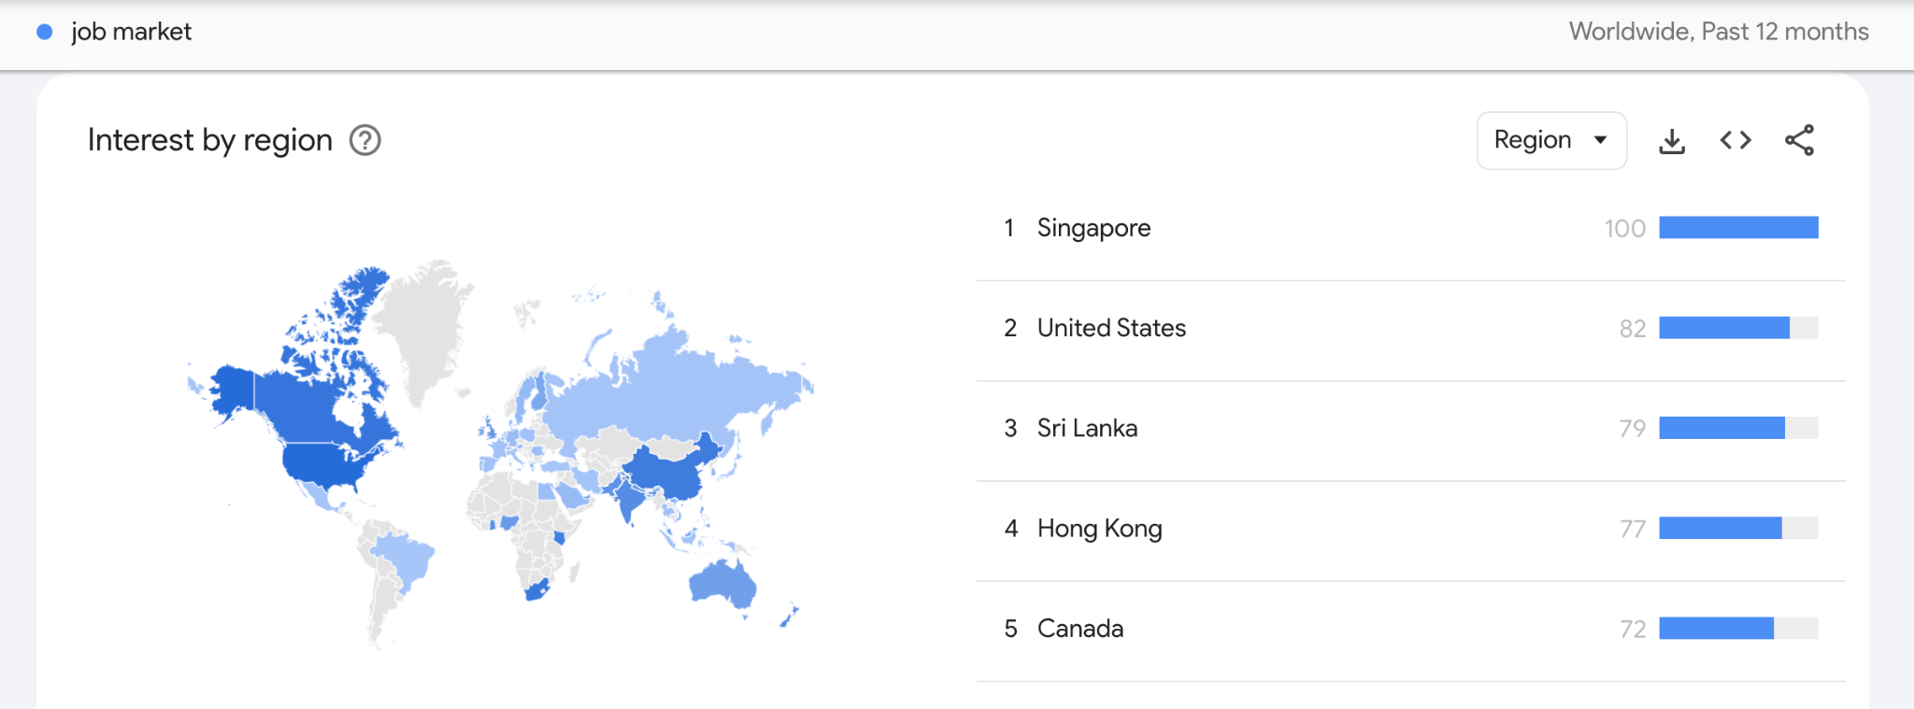
Google trends
* Note: A higher value means a higher proportion of all queries, not a higher absolute query count. So a tiny country where 80% of the queries are for "bananas" will get twice the score of a giant country where only 40% of the queries are for "bananas".

Slide 7

Analysis
Filtering Target Jobs
Job Search Strategies
Correlation Analysis of Key Goals and Variables
Required Skills for Target Jobs
Evaluating Cities Based on Salary

Slide 8

Data Visualization
Tableau: https://public.tableau.com/views/BIfinalproject_17338511313740/Dashboard1?:language=zh-TW&publish=yes&:sid=&:redirect=auth&:display_count=n&:origin=viz_share_link
Python: https://colab.research.google.com/drive/1LTw0hGpHnhqSFGwpUwml-J7ypGM3YorY?usp=sharing

Slide 9
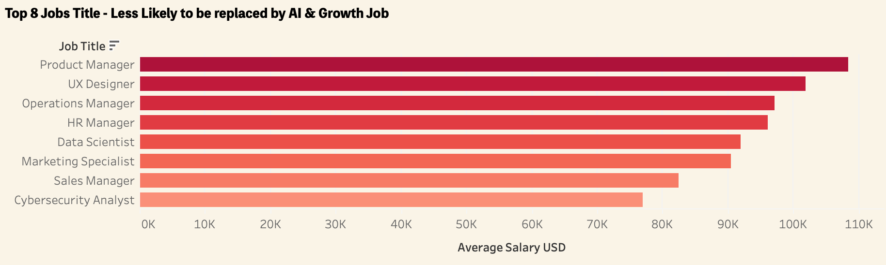
Filtering Target Jobs
We filter jobs based on three criteria: low automation risk, above-average salaries, and high growth potential. This step identifies roles that align with our career goals and narrows down industries and job types for further analysis.
Notes:
nsight: These roles provide strong career stability, competitive salaries, and growth potential. These roles cover both technical and non-technical fields, making them accessible for students with diverse backgrounds. Conclusion: Students should prioritize these fields for career planning. - jerry

Slide 10
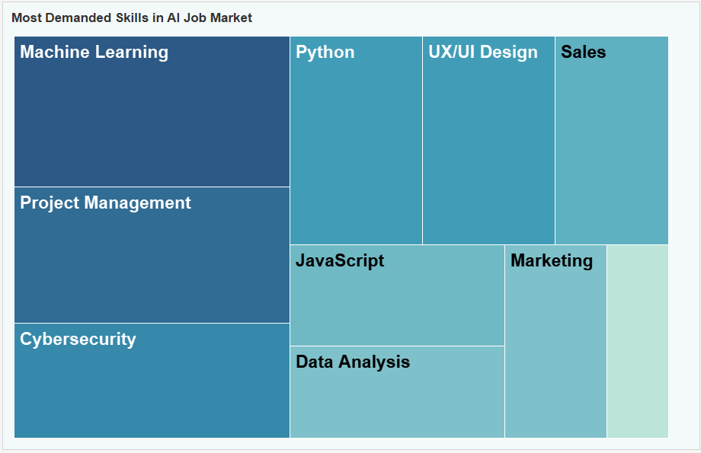
2. Required Skills for Target Jobs
By analyzing the skills needed for jobs identified in the first story point, we can pinpoint in-demand skills across industries. This insight helps us focus on developing the capabilities required for high-potential roles.
Notes:
Combining technical skills (machine learning, python) with soft skills (management/design) is crucial for staying competitive. Employers increasingly value cross-functional skills, such as combining data analysis and marketing expertise. Focus on developing skills that align with target job requirements, especially those with broad industry demand. - Jerry

Slide 11
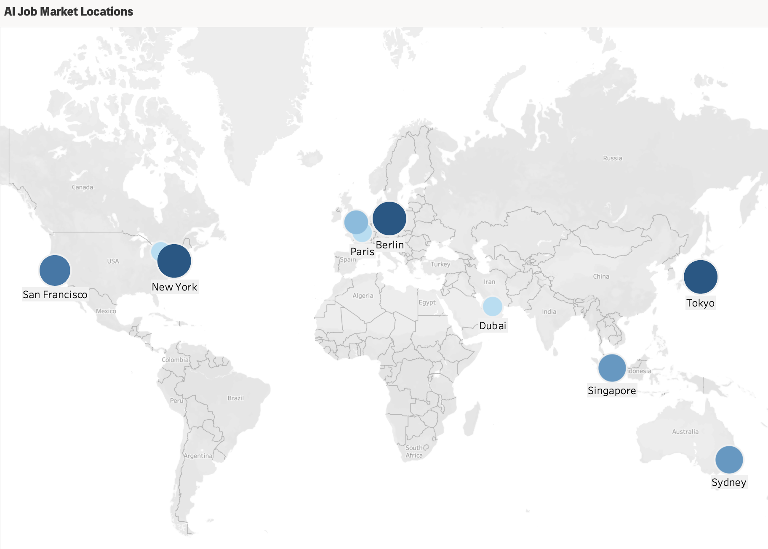
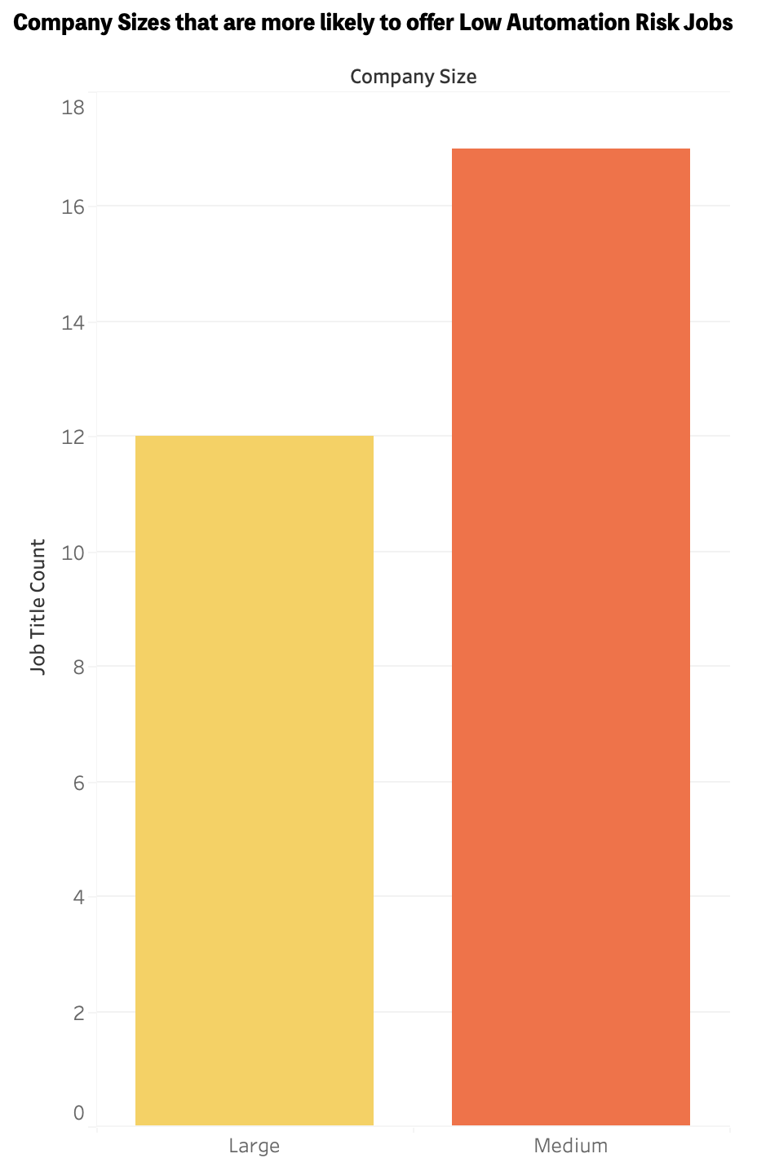
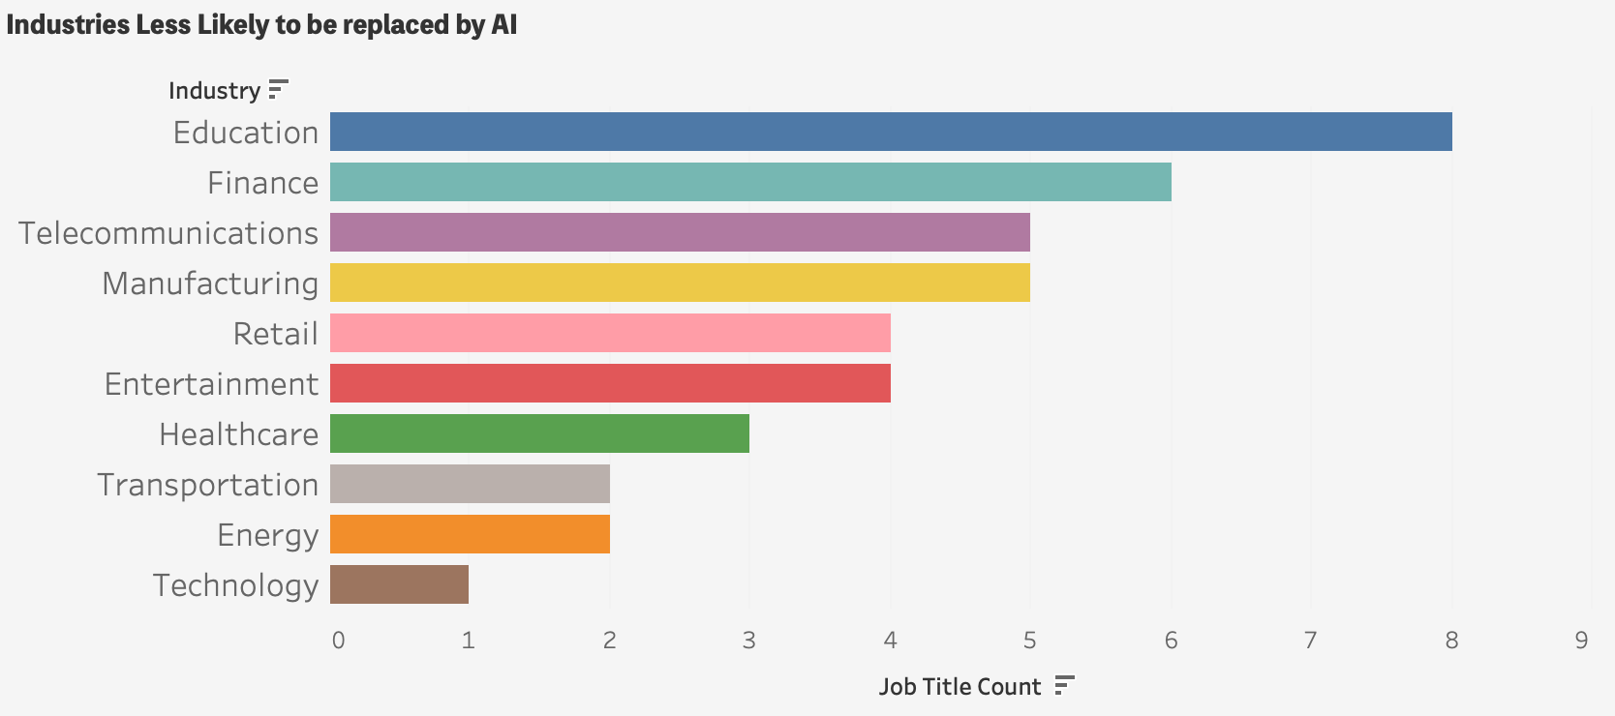
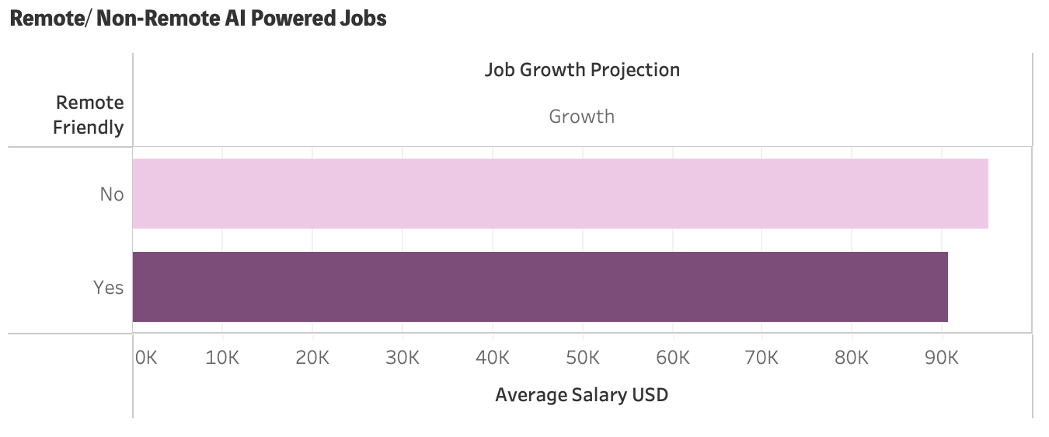
3. Job Search Strategies
To improve our job search, we explore variables such as company size, location, industry, and remote-work compatibility. This analysis helps us understand where and how to focus our efforts to find jobs that meet our criteria.
Notes:
Medium sized companies offer more opportunities than large ones. Industry: Top three: education, finance, telecommunication. Location: Tokyo - New York-Berlin- San Fran-Sydney-Singapore. Remote/non show similar salary and opportunity trends. Conclusion: strategically target companies and cities with high potential while considering industry trends.

Slide 12
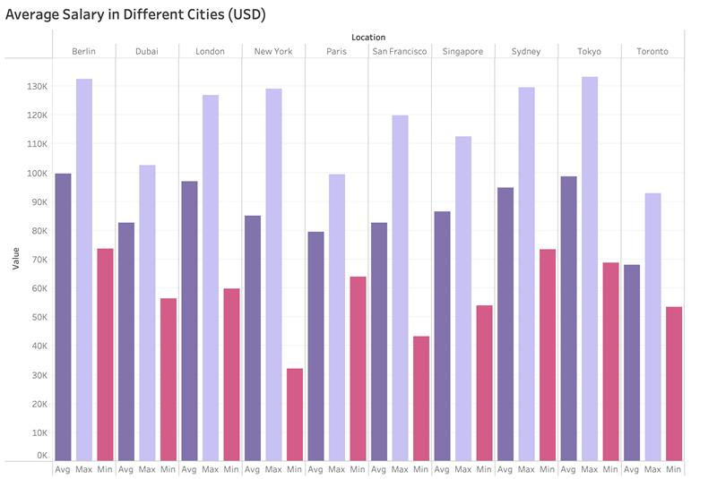
4. Evaluating Cities Based on Salary
We compare the average salaries and salary distributions across major international cities. This helps us determine the best locations for pursuing careers based on job availability, industry trends, and salary consistency.
Notes:
Average, maximum, and minimum salaries vary significantly across cities, with remote-friendly roles often offering higher average salaries.Berlin and Tokyo offer competitive compensation for various job types.Insights:Remote-friendly roles provide flexibility and often higher pay. Conclusion:Choose cities with a good balance of living costs and salary potential when selecting a career location.
Additional Insights:Although remote roles tend to have higher pay, cities with lower living costs (e.g., Berlin) can further boost real earnings.
Non-salary factors, such as work culture and growth opportunities, should also be considered when selecting a city.

Slide 13
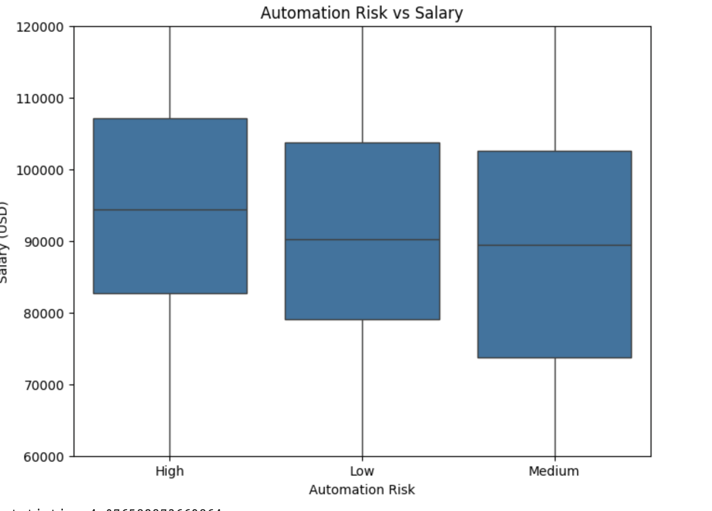
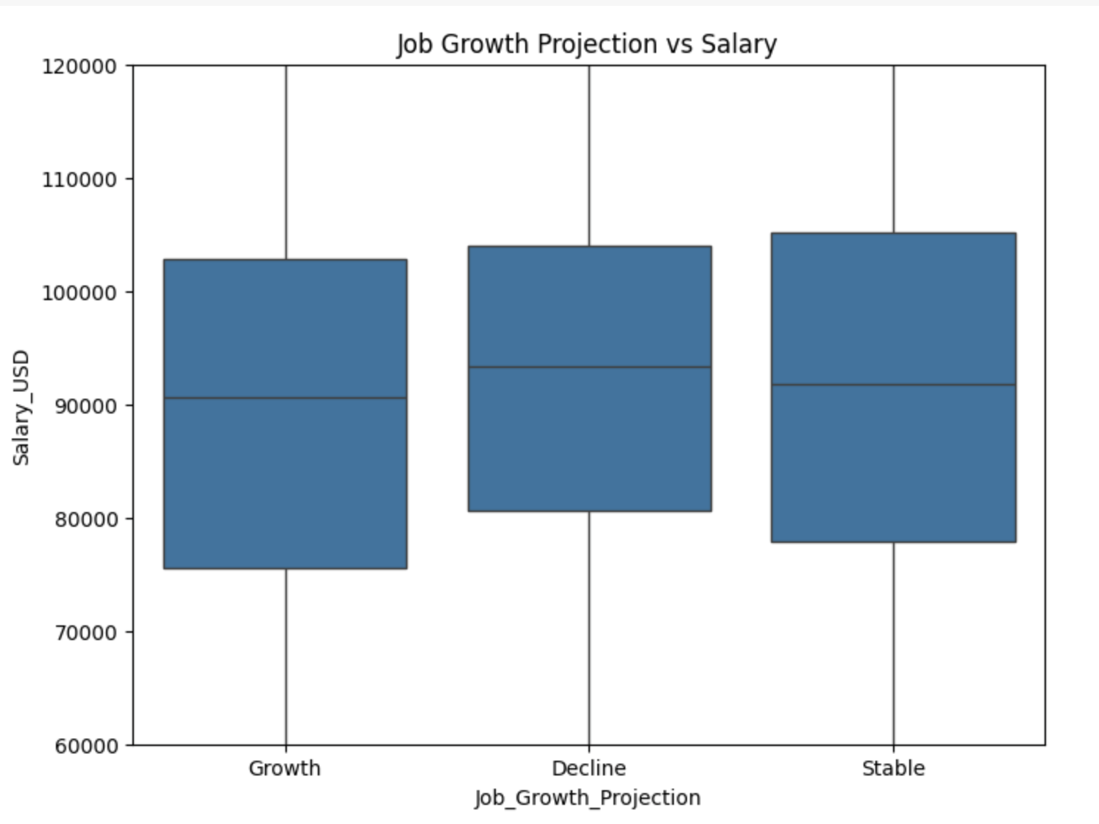
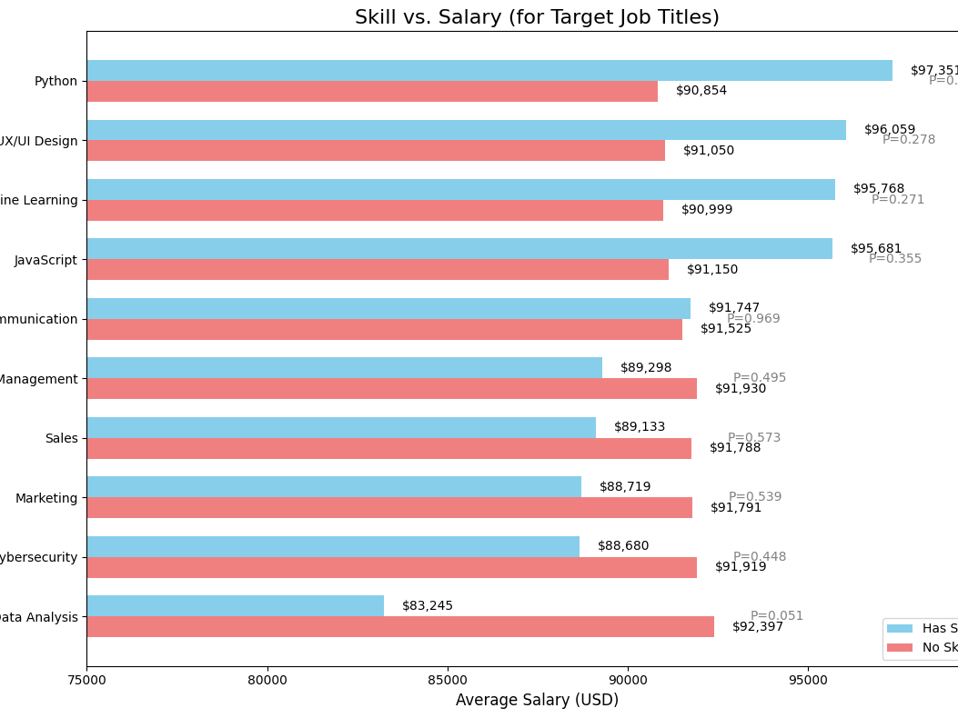
5. Correlation Analysis of Key Goals and Variables
Automation Risk vs. Salary: Jobs with low automation risk tend to have higher salaries.
Growth Projection vs. Salary: A positive correlation exists between growth potential and salary levels.
Skills vs. Salary: High-demand skills like Python, Machine Learning, and UX/UI Design show strong average salaries.
Notes:
We analyze the relationships between key goals, such as automation risk and salary, with other variables like company size and location. This helps us identify patterns and factors that influence job prospects and career decisions.Insight:Automation-resistant, growth-oriented roles with in-demand skills tend to offer higher salaries.Conclusion:Invest in skills with proven salary advantages and target roles with high growth and low automation risk.

Slide 14

Actionable Recommendations
Skill Development
Technical Skills: Prioritize learning Python, Machine Learning, and UX/UI Design.
Soft Skills: Strengthen project management and communication skills to improve cross-departmental collaboration.
Career Location
Focus on Berlin, Tokyo, and New York, which offer a combination of salary opportunities and growth industries.
Job Strategy
Target medium-sized companies that typically provide more flexible growth opportunities.
Consider high-demand industries such as Education and Finance for added stability.
Flexibility
Explore remote roles for higher salaries and better work-life balance.

Slide 15

Conclusion
Industry Adaptability: Education and finance industries balance low automation risk with stable growth, making them ideal for graduates seeking security.
Skill Combination Strategy: Students should pursue a learning path combining technical and general skills (e.g., Data Analysis + Marketing) to maximize employment options.
Location Selection Considerations: Cities like Tokyo and Berlin stand out for balancing salary and living costs, making them attractive for budget-conscious job seekers.

Slide 16
Reference
Dataset
https://www.kaggle.com/datasets/uom190346a/ai-powered-job-market-insights
Google Trends
https://trends.google.com/trends/explore?q=job%20market&hl=en
Tableau
https://public.tableau.com/views/BIfinalproject_17338511313740/Dashboard1?:language=zh-TW&publish=yes&:sid=&:redirect=auth&:display_count=n&:origin=viz_share_link
Python
https://colab.research.google.com/drive/1LTw0hGpHnhqSFGwpUwml-J7ypGM3YorY?usp=sharing

Slide 17

Thank you

